Slide 1

Overtime Online Approval System Time & Attendance System
System Demo Presentation
Prepared by:
Ervin Olinas Brosas
ICT Department

Slide 2
Agenda:
Introduction to Overtime Online Approval System
Key Features
Cost Centers List
Current Workflow Setup
System Demo

Slide 3
Introduction:
Benefits of automated Overtime Online Approval System:
Centralized data storage, records can be traced easily.
Increases productivity and efficiency by eliminating the manual process
Paperless, reduces printing cost.
Has built-in workflow engine that handles the approval process and sending of system notification to approvers automatically.
Web based, system is installed in a centralized web server.
In-house developed, no license cost.

Slide 4
Key Features:
Allows multiple submission and approval of overtime requests in one go.
Keeps track of all approval and workflow transactions and notifies all persons in the approval line whenever the request is rejected or modified by HR.
Authorized users can search for overtime requisitions and data can be filtered by employee no., cost center, current assignee, creator, status, and date period.
Automatic reassignment to the substitute in case the approver is not available.
Automatic escalation to the next approver in the process flow if system checked that same person already approved the request.
Access to the system is controlled and given only to authorized users.
Integrated with other GARMCO systems such as JDE and Swipe System.

Slide 5
OT Enabled Cost Centers:
Cost Center | Cost Center Name | Company Code | Group Code
2110 | REMELTMELTINGCASTING | 00100 | PRD
2111 | GREENFIELD REMELT EXPANSION | 00100 | PRD
2112 | EMP | 00100 | PRD
3220 | SCALPING | 00100 | PRD
3230 | PREHEATSLABHEATINGFURNACE | 00100 | PRD
3240 | HOTMILL | 00100 | PRD
3250 | ROLLGRINDING | 00100 | ENG
3310 | ANNEALINGCOOLINGBOOTHS | 00100 | PRD
3320 | COLDMILL1 | 00100 | PRD
3322 | COLDMILL2 | 00100 | PRD
3410 | TENSION LEVELLER 1 | 00100 | PRD
3412 | TENSIONLEVELLER2 | 00100 | PRD
3415 | TENSION LEVELLER 3 | 00100 | PRD
3420 | SLITEMBOSS | 00100 | PRD
3430 | CTLRFGUIL | 00100 | PRD
3470 | PACKINGINCLCARPENTRY | 00100 | PRD
3800 | GENERALFACTORY | 00100 | PRD
4100 | QUALITYCONTROLWORKS | 00100 | QC
4200 | LABORATORY | 00100 | QC
5200 | MECHANICALENGINEERING | 00100 | ENG
5300 | ELECTRICALENGINEERING | 00100 | ENG
7150 | ADMINISTRATION SERVICES | 00100 | S&M
7200 | SAFETYSECURITY | 00100 | ADM
7250 | MEDICALSERVICES | 00100 | ADM
7300 | STORES | 00100 | ADM

Slide 6
Current Workflow Setup:
Production:
Head of Department / Shift Supervisor
Department Manager
Senior Production Manager
GM Operations
HR Validator
Head of HR
Engineering (Electrical, Mechanical, Utility & Roll Grinding):
Head of Department / Shift Supervisor
Department Manager
Senior Engineering Manager
GM Operations
HR Validator
Head of HR
QC & Lab:
Head of Department / Shift Supervisor
Department Manager
Senior QC Manager
GM Operations
HR Validator
Head of HR

Slide 7
Current Workflow Setup:
Security:
Direct Supervisor
Department Manager
Senior HR & Admin. Manager
HR Validator
Head of HR
Medical:
Department Manager
Senior HR & Admin. Manager
HR Validator
Head of HR
Safety:
Head of Department
Senior HR & Admin. Manager
HR Validator
Head of HR
Stores:
Head of Department
Department Manager
HR Validator
Head of HR

Slide 8
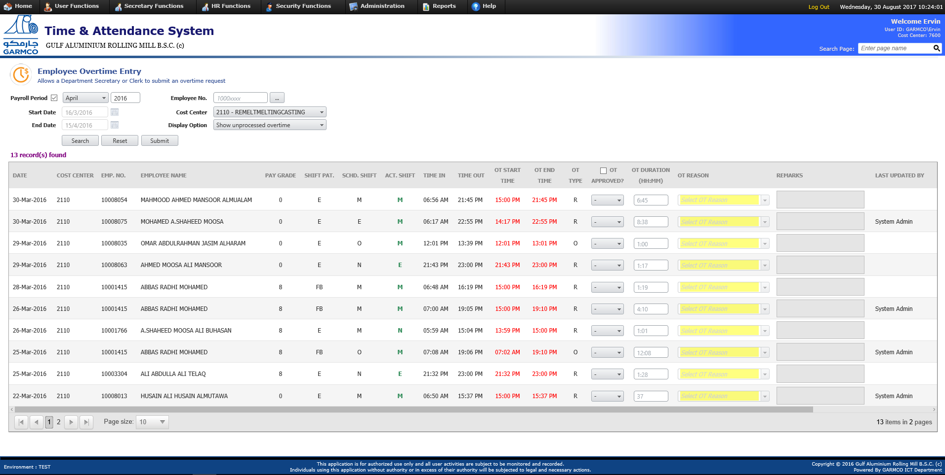
System Demo:

Slide 9
Thank You!

